Slide 1


Machine Learning in R
Leonard Wee
orcid.org/0000-0003-1612-9055

Slide 2
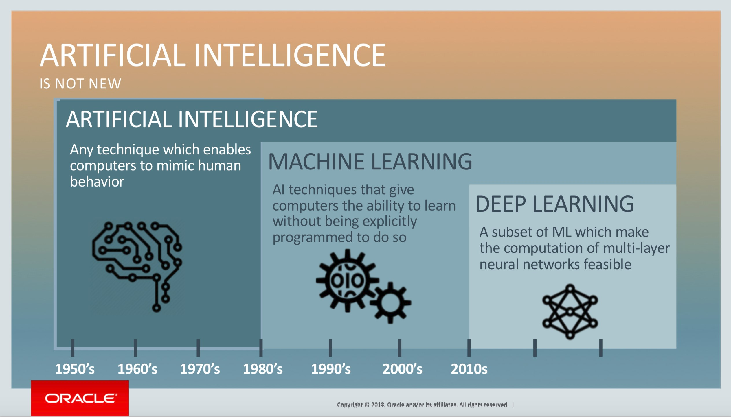
ML and DL grew out from computer science

Slide 3
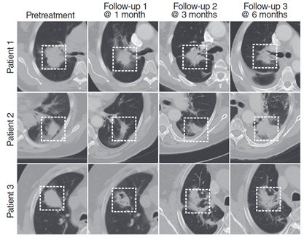
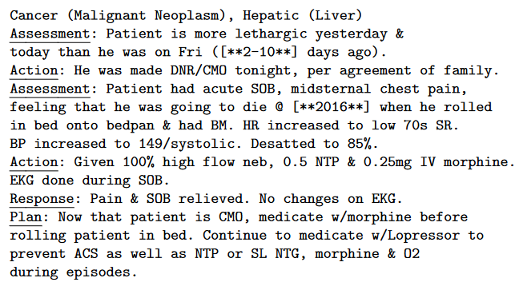
Possible input sources for ML/DL
rr | oxygen_sat | urea | crp | gcs | age | female | comorbidity | date | set | mortality
33 | 90 | 26,2 | 129,5 | 13 | 54 | 0 | 2 | 6-feb-20 | dev | 0
25 | 92 | 21,3 | 171,2 | 15 | 86 | 0 | 2 | 6-feb-20 | dev | 1
26 | 89 | 5,6 | 164,0 | 15 | 86 | 1 | 1 | 6-feb-20 | dev | 1
14 | 80 | 24,4 | 137,4 | 15 | 88 | 0 | 2 | 6-feb-20 | dev | 1
17 | 90 | 6,7 | 296,0 | 15 | 86 | 0 | 0 | 6-feb-20 | dev | 0
42 | 92 | 17,5 | 127,2 | 13 | 55 | 1 | 1 | 6-feb-20 | dev | 1
19 | 91 | 4,1 | 37,7 | 15 | 76 | 0 | 1 | 6-feb-20 | dev | 1

Slide 4
Learning Objectives
What is ML
Understand the approach
ML work cycle
Interpretation
Classification
Regularized logistic
Trees and forests
Support vector models
Using R
Caret package
Train 3 models
Introduction to SHAP

Slide 5
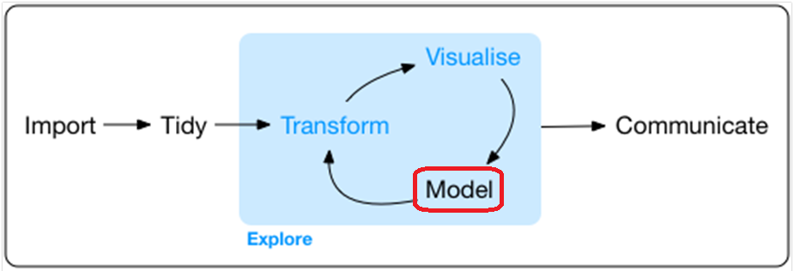
Online Resources
R for Data Science : https://r4ds.had.co.nz/ (Hadley Wickham)
The caret package : https://topepo.github.io/caret/ (Max Kuhn)

Slide 6
Some important terminology
Data PRE-PROCESSING
FEATURE SELECTION
HYPER-PARAMETERS
EXPLAINABILITY

Slide 7

Regression compared to classification

Slide 8
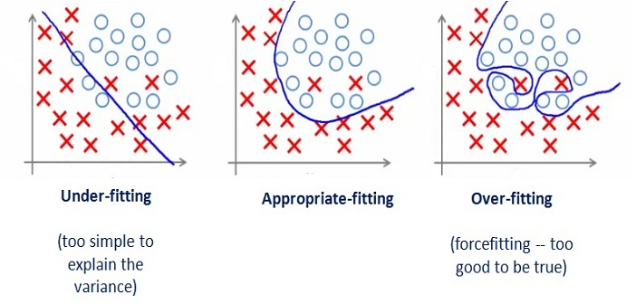
Classification - CAUTION

Slide 9
Parameter estimation compared to prediction
One of the key aims of Statistical Modelling :
“Obtain the most accurate estimation of the parameters describing the true relationship between the control variable(s) and the response variable(s)”.
e.g. the true Hazard Ratio / Odds Ratio of serum cholesterol for heart attack
One of the key aims of Machine Learning :
“Obtain the most accurate prediction of the expected outcome for an individual having certain initial characteristics.”
e.g. whose cancer is going to return within 2 years after having surgery

Slide 10

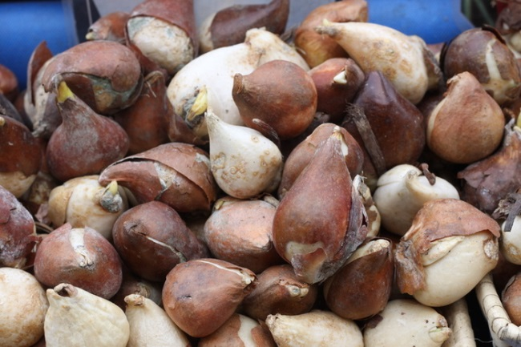
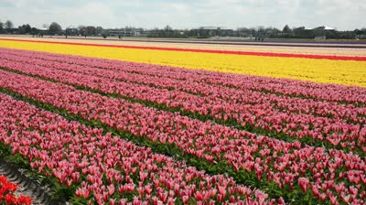







Slide 11



AUC
1.00
0.72
0.50

Slide 12
Complementary approaches
Classical modelling
Most accurate parameter estimation possible
Hypothesis driven
Mostly (but not all) parametric models
Assumptions (re model) can be strong
Prominent (pre-eminent) role of pre-existing knowledge and domain expertise
Usually directly intuitive / interpretable
Machine learning
Most accurate individual-level prediction possible
Data driven
Parameterization is useful but not essential
Assumptions (re model) are somewhat weaker
Pattern recognition and phenomenological
Can be explainable but generally much less interpretable

Slide 13
Examples of questions
Classical modelling
If I reduce the number of hospital beds by 10%, what is the expected increase in mortality?
After correcting for age and sex, is there a relationship between serum cholesterol and heart disease?
If I wish to raise my market share by 10%, should I spend money on advertising the existing credit card or launch a new credit card?
Will a social-media based public health campaign reduce smoking rates among young women by 25%?
Machine learning
If I give this particular Br Ca patient in front of me a higher radiation dose to the breast, does her cancer recur within the next 2 years or not?
Should I put this person with these specific blood level readings on a “surveillance” plan for heart attack?
This customer is right now asking for a home loan of $200k, shall I approve it or not?
Which order of ads should I present on the smartphone of this young woman to encourage her to quit smoking?

Slide 14
Some important terminology
Data PRE-PROCESSING
Dimensionality REDUCTION
Model tuning HYPER-PARAMETERS
Model EXPLAINABILITY

Slide 15
Pre-processing
Step 1 : Are there any columns with little or no variation?
Step 2 : Are there missing values? Should we impute or not?
Step 3 : (Multi)-collinearity – does anything need to be done about it?
Step 4 : Categorical variables – recode these. Numerical values – consider if scaling/transform/centering is needed
Step 5 : Which subjects to “train” on and which to validate on?

Slide 16
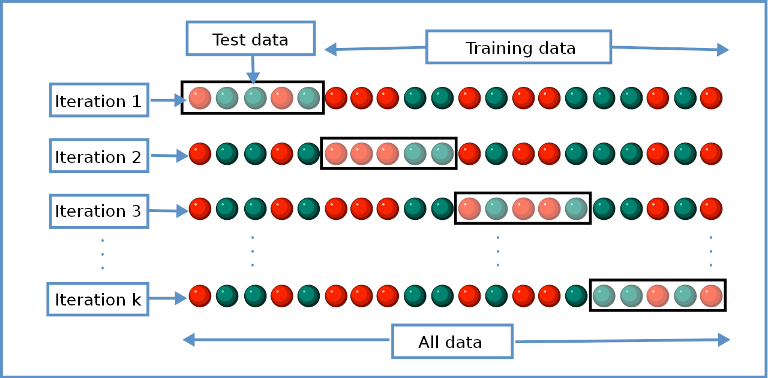
K-fold sampling

Slide 17
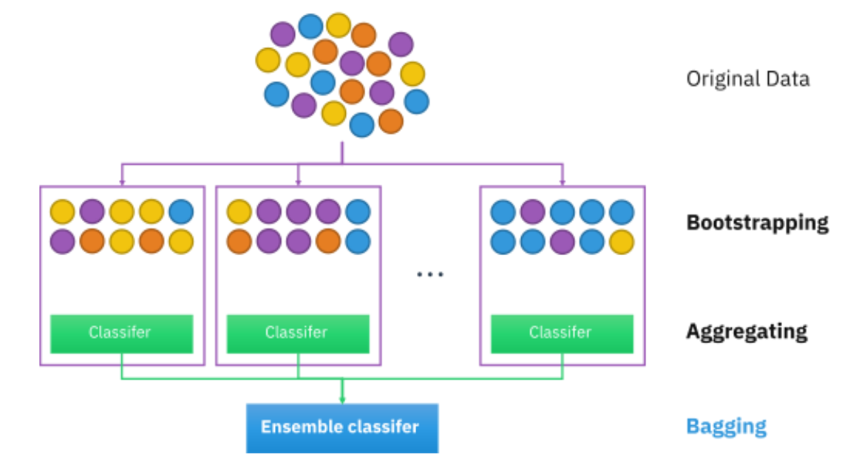
Bootstrap sampling
Independent estimates of model performance in a large “true” population
But based on a finite one
Assumptions?
Confidence intervals
Over-optimism estimation
Variations include:
- Minority oversampling
- Majority undersampling

Slide 18

Regularized (logistic) regression
We frequently use regularization to make a machine learning model less sensitive to data that is not in the training set.
But how do we know what data is NOT in the training set?!?
Answer : K-folds and/or bootstraps for cross-validation, to estimate the distribution of data outside training
Least Absolute – Shrinkage and Selection Operator (LASSO) :
Lasso penalty shrinks or reduces the coefficient value towards zero.
Least-contributing variables are gradually “shrunk” …
Towards zero or almost-zero coefficients, leaving strongly-contributing ones.
Hyper-parameter LAMBDA 1 (λ1) which is the “cost” of a non-zero coefficient
The model optimizers job is to drive the cost to the minimum.

Slide 19

Regularized (logistic) regression
RIDGE regularization applies lambda to the SUM OF SQUARES of coefficients
(cf lasso penalty on the absolute value of coefficients)
Ridge penalizes relatively large or relatively small coefficients.
Coefficients are gradually “shrunk” …
Towards the same magnitude of coefficients!
Hyper-parameter LAMBDA 2 (λ2) which is the “cost” of differences.
The model optimizers job is to drive the cost to the minimum.
ELASTIC NET == linear mixing of λ1 and λ2 penalties.
Hyper-parameter ALPHA (α) : α = 0 means pure RIDGE, α = 1 means pure LASSO.

Slide 20
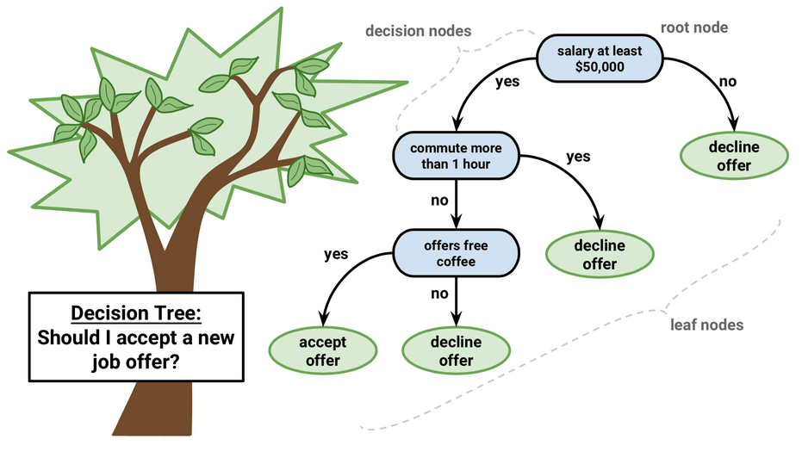
Tree-based classifiers
Based on the classical decision tree :
Applying many consecutive if-then rules
ML trees do not require expert guidance to select the nodes and decision values.
Usually classification (but some trees can be used to predict values at the output nodes i.e. regression).

Slide 21
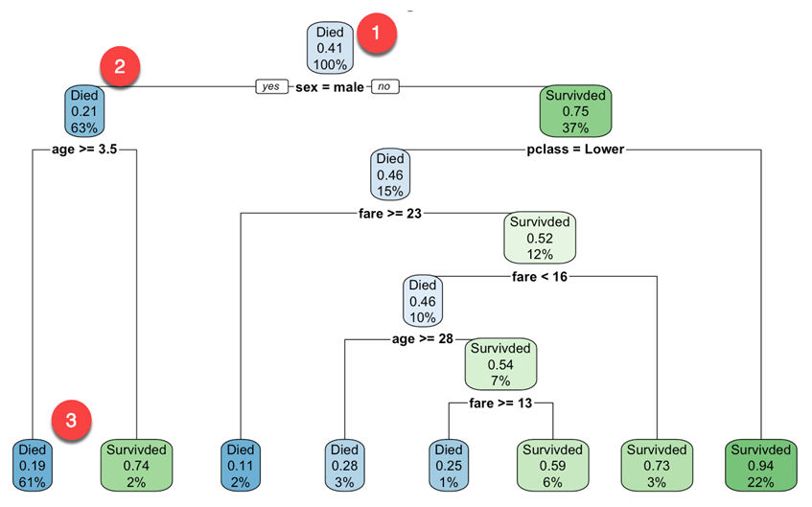
Interpretation of tree-based classifiers
Assuming the Titanic is representative of ship sinking events, then predict - given certain passenger characteristics - whether he/she will die or survive.
e.g. 17 year-old female in 1st class cf 20-year old male in 3rd class?
Interpretability?
Explainability?
Generalizability?
What is your opinion?

Slide 22
Construction of tree-based models
Any similarities with UNSUPERVISED CLUSTERING?
Main principle - in any given tree and each of its sub-tree(s),
Minimize entropy within subgroups, and
Maximize information gain ie biggest change (in entropy) when choosing a threshold to split to subgroups
Therefore we need an entropy metric -> Gini index (class heterogeneity) is default in R tree package
(Hyper-parameter) Human needs to decide where to CUT THE TREE to avoid fitting model on singular (or extreme) events

Slide 23
Random forest model (extending tree classifier)
Random Forests (RFs) == very large ensemble model containing very many independent tree models.
(Hyper-parameter) Human expert can decide how many variables per tree?
(Hyper-parameter) Human expert can decide how many trees in total?
The output of random forest (nb – there are many variations on the random forest theme) :
(passenger characteristics) == “died” (i.e., most popular vote among all the trees)
Interpretability? Explainability? Generalizability? What is your opinion?

Slide 24
SHapley’s Additive exPlanations (SHAP) in R
Suppose a group of you are doing a joint assignment.
If nobody did anything, you would all get a joint “1” score ie you wrote your name and submitted it ☹
You all did some (but varying) amounts of work and the group grade was “8” ☺
Behavioural economist : “Can we calculate the contribution of each member towards the group net profit of 7?
If you are interested in the game-theoretic modelling and answers, look up :
Shapley, Lloyd S. (August 21, 1951). "Notes on the n-Person Game -- II: The Value of an n-Person Game" (PDF). Santa Monica, Calif.: RAND Corporation.
Shortish answer : We try out every possible combination of variables, and rank variables one-by-one according to which brings us closest to the final overall predicted class probability.

Slide 25
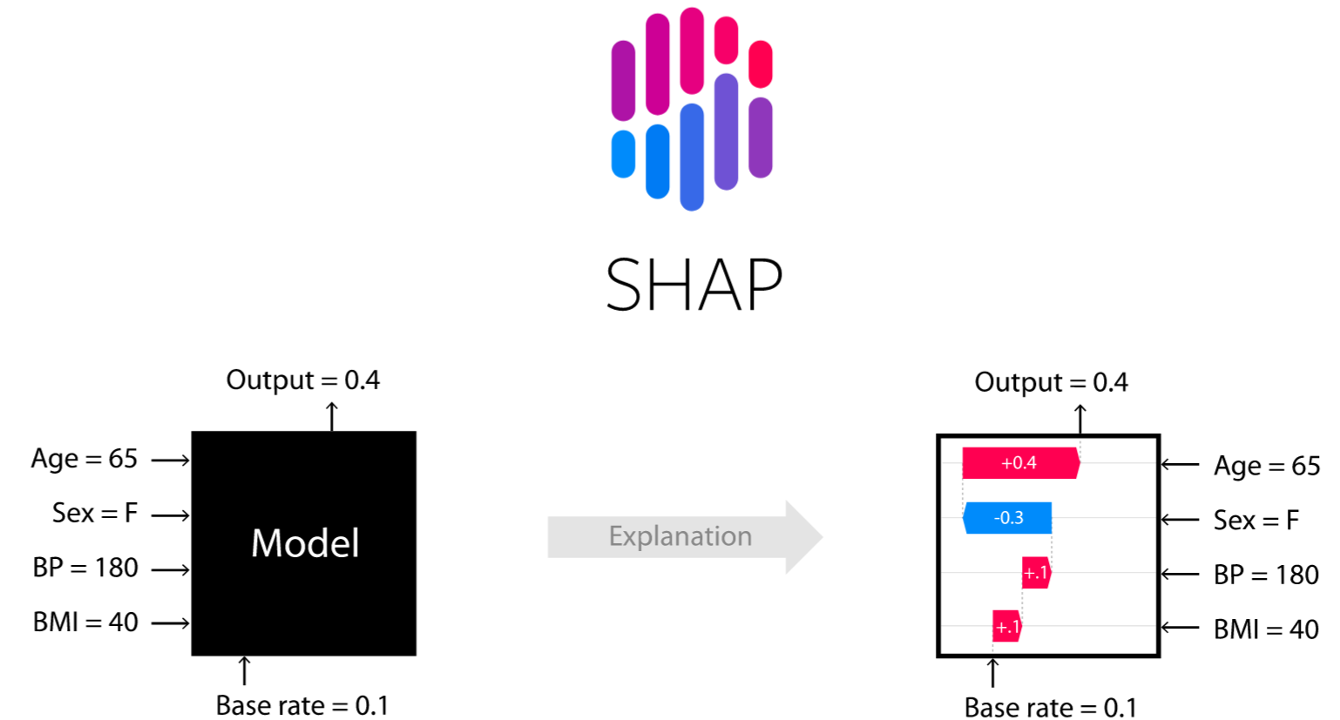
SHapley’s Additive exPlanations (“SHAPPER” in R)
Main objective is not to calculate ourselves but interpret the output :
Train a model first
Feed in a new “patient”
Extract prior and posterior class probabilities
Calculate the Shapley values for each variable
Rank and display

Slide 26
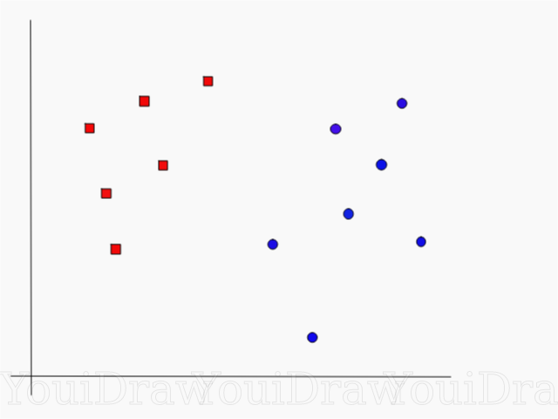
Support vector models – linear space
Example : Draw a classification line to divide the “red” outcomes from the “blue” outcomes.

Slide 27
Support vector models – linear space
Example : Draw a classification line to divide the “red” outcomes from the “blue” outcomes.

Slide 28
Support vector models – linear space
Example : Draw a classification line to divide the “red” outcomes from the “blue” outcomes.

Slide 29
Support vector models – linear space
Example : Draw a classification line to divide the “red” outcomes from the “blue” outcomes.

Slide 30
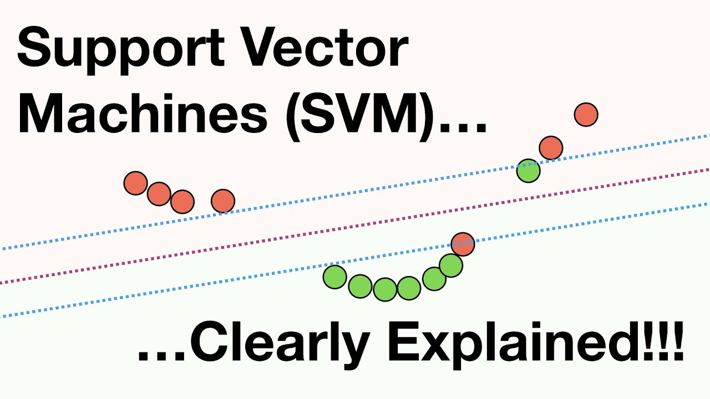
Support vector models – linear space
What happens if the boundary is noisy?
https://www.youtube.com/watch?v=efR1C6CvhmE

Slide 31
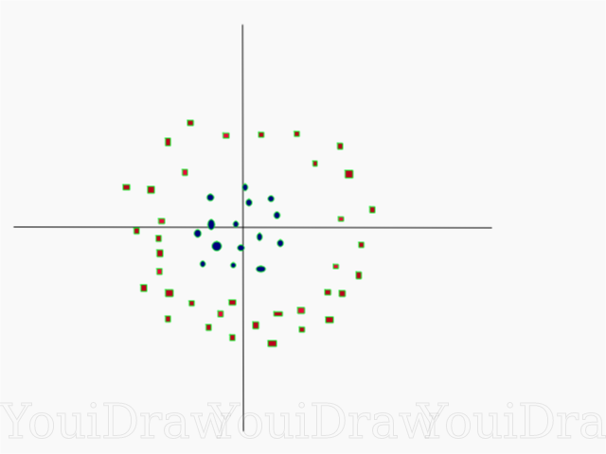
Support vector models - nonlinear
Now try this one …

Slide 32
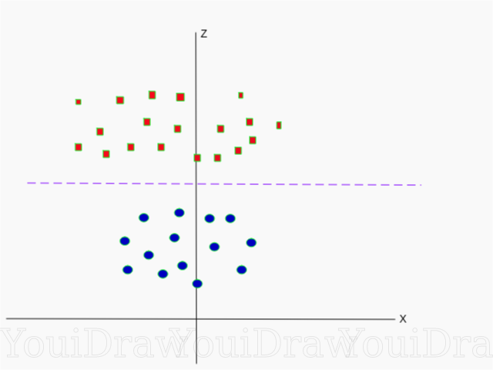
Support vector models – non-linear
Effect of a transforming from a Cartesian to a Radial coordinate system …
r

Slide 33
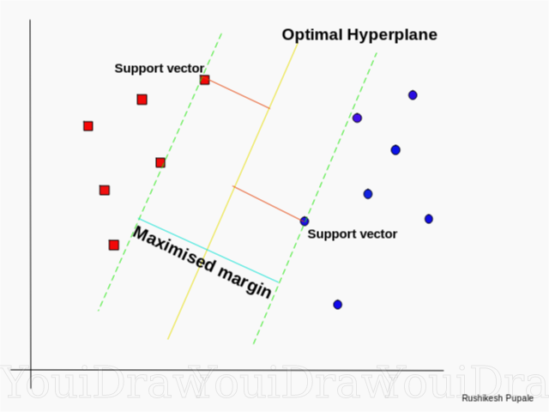
Support vector models
Hyperplane : “In n-dimensional space, the hyperplane is a (n-1) dimensional surface that cuts the space into two distinct regions.”
An SVM optimal hyperplane is the one that divides the data points so that the labels have minimum overlap and maximum distance from the hyperplane.
Linear SVM = n-dimensional Cartesian space
Radial SVM = n-dimensional Spherical space

Slide 34
Coming up in next practice session :
Look in detail at 3 machine learning models
Covid-19 dataset
Please install “caret” R library in advance of the practice session
caret documentation : https://topepo.github.io/caret/

Slide 35
Learning Objectives
What is ML
Understand the approach
ML work cycle
Interpretation
Classification
Regularized logistic
Trees and forests
Support vector models
Using R
Caret package
Train 3 models
Introduction to SHAP

